Slide 1
ENTITY FRAMEWORK
12 December 2024
Shriwatsal Patil

Slide 2
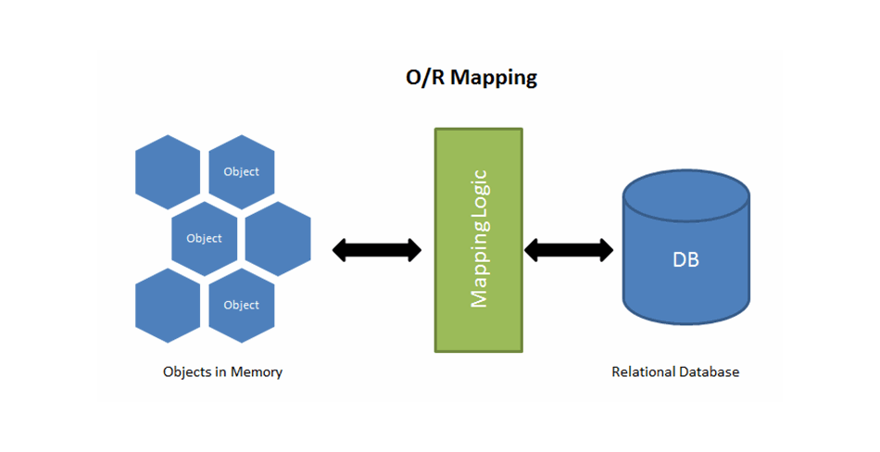
Entity Framework- ORM
What is ORM ?
ORM –Object Relational Mapping
Working with Database using OOP concepts
ORM Working Flow
Classes and Objects – Mapping with Tables
Approaches – Database First Or Code First
Database Interaction – Automatic translation to queries
LINQ – Language Integrated Query
write strongly-typed queries in C# instead of SQL
Different ORM Frameworks
Entity Framework
Dapper
Nhibernate
Linq2Db
Servicestack Ormlite

Slide 3
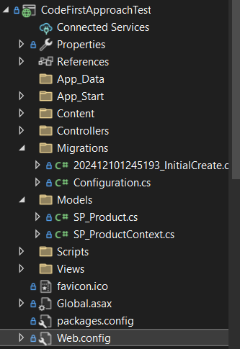
Code First Approach
Flow for Code First Approach
Installing Entity Framework
Create SP_Product.cs – Entity
Create SP_ProductContext Class
Add Connection String
Tools→Nuget Package Manager→Package Manager Console → Commands
Enable-Migrations
Add-Migration InitialCreate
Update-Database

Slide 4
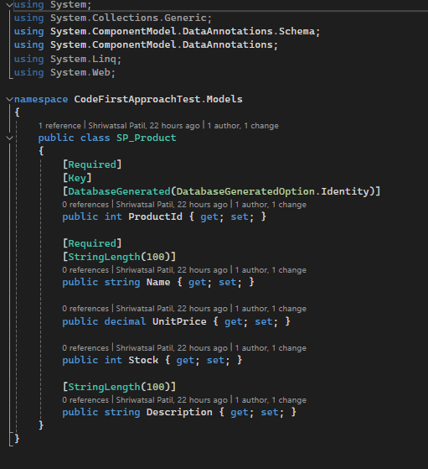
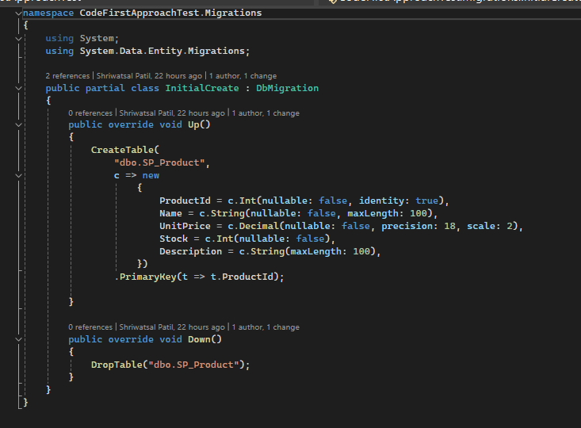
Implementation of Code First Approach
.

Slide 5
Key Concepts of Entity Framework
DbContext -- Central Class in Entity Framework
DbSet<T> -- Collection of Entities
Entities – Entity Framework Mapping with Class
LINQ – Allows users query to Database using LINQ syntax
Migrations – To manage Schema changes
Change Tracking – using SaveChanges();

Slide 6
Entity Framework Workflow
Define Models
Use DbContext→ Dbset<T>
Use LINQ to use Query Logic
SaveChanges
Apply Migrations

Slide 7
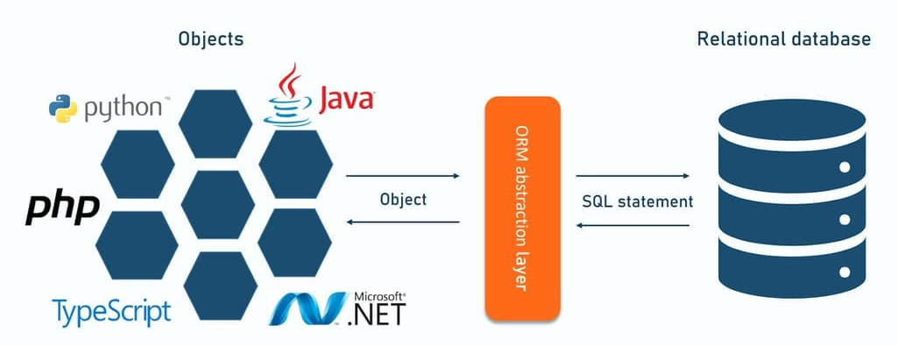
Advantages and DisAdvantages of Entity Framework
Advantages
Abstraction from SQL
Productivity
Maintainability
Cross Platform
Disadvantages
Performance
Learning curve
Abstraction Overhead

Slide 8




THANK YOU
(844) 720-6678
info@simplifyhealthcare.com
simplifyhealthcare.com
Simplify Healthcare
U.S.: 600 N Commons Drive, Suite 110, Aurora, IL 60504
India: 401/402, 4th Floor, Pentagon P-2, Magarpatta City, Pune 411013
CONNECT WITH US
LinkedIn
YouTube
X
Instagram

